Slide 1

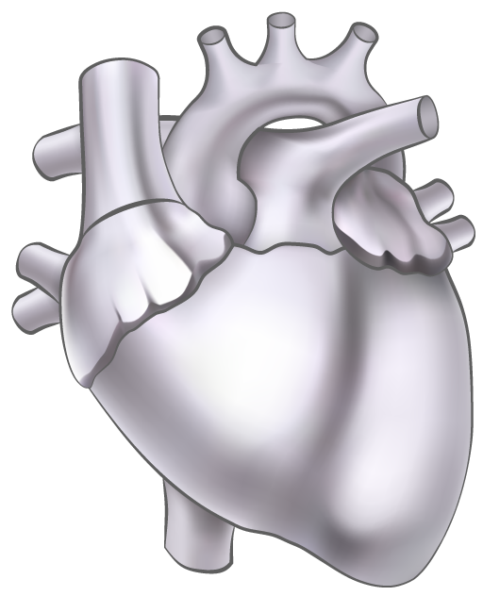
IDENTIFYING KEY INDICATORS FOR HEART DISEASE
Dhanush Srinath
Dharmaja Patel
Akhil Khajur
“The problem with heart diseases is that the first symptom is often taken lightly”

Slide 2
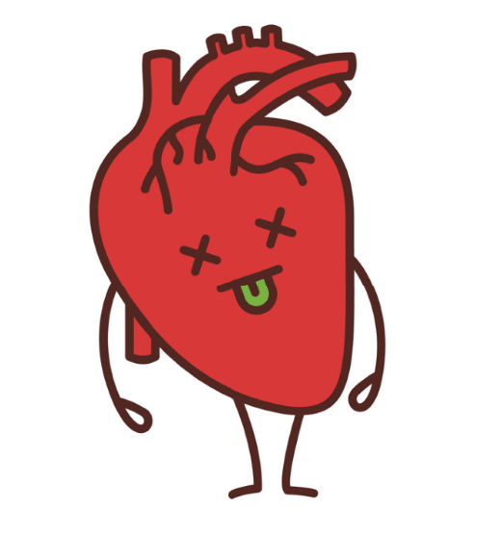



Why is it important?
#1 Killer 🔪 - Leading cause of deaths in the United States
Every 40 seconds someone dies from a heart disease in the United States
It's the biggest threat to insurance companies - Highest cost of treatment.
It’s on an increasing trend despite the advances in the medical field. Why?

Slide 3




Data Analysis (We won’t bore you)
Quite challenging to pre process
Data standardization
What factors?
And why?
Individual survey based responses (Unit of analysis)

Slide 4
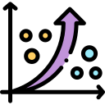

Predictive analysis
Logistic regression
Model Accuracy : 90.62%
Model Precision:
53.8%
Logistic regression model for predicting what factors affect heart diseases the most.

Slide 5



Cluster Analysis
Cluster 1
Cluster 2
Cluster 3
Low chance of heart disease
High physical activity
Low alcohol consumption
Low healthcare costs
Mostly male, with a mean age of 50-54 and a high income
High prevalence of heart disease
High prevalence of diabetes and smoking
Low healthcare costs
Poor general health and mental health
Mostly female, with a mean age of 60-65 and a low income
Moderate prevalence of heart disease
Moderate healthcare costs
Average general health and mental health
Mostly female, with a mean age of 50-54 and a high income

Slide 6

Visualizations

Slide 7

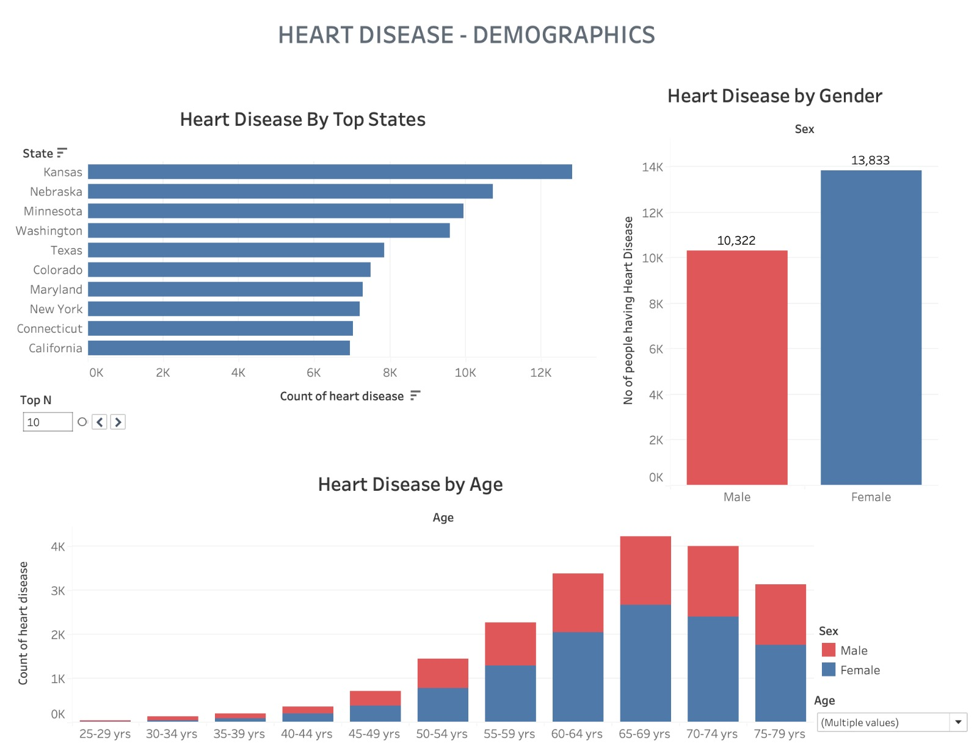

Slide 8
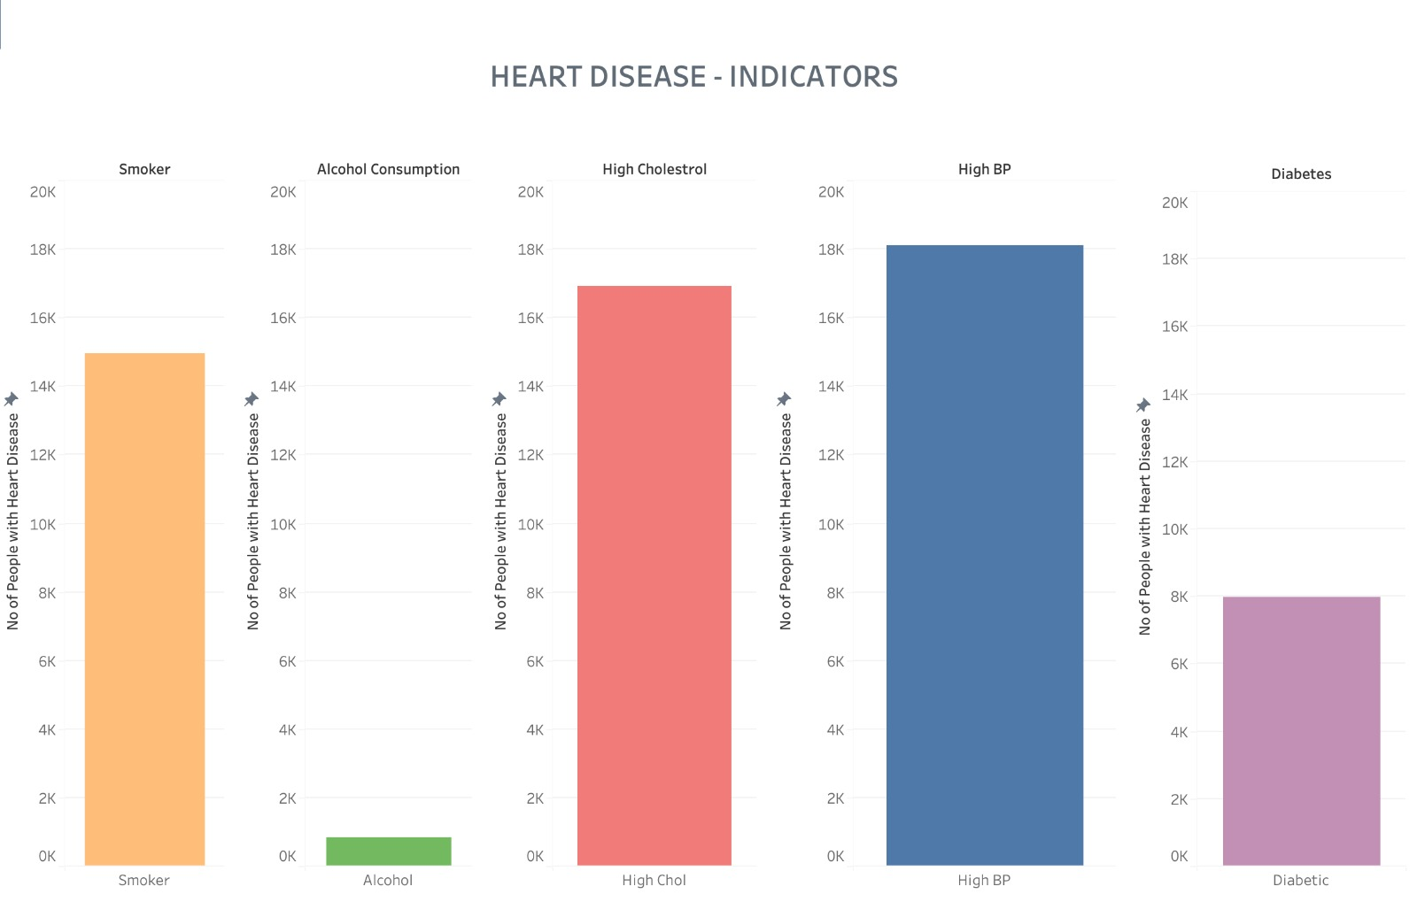

Slide 9

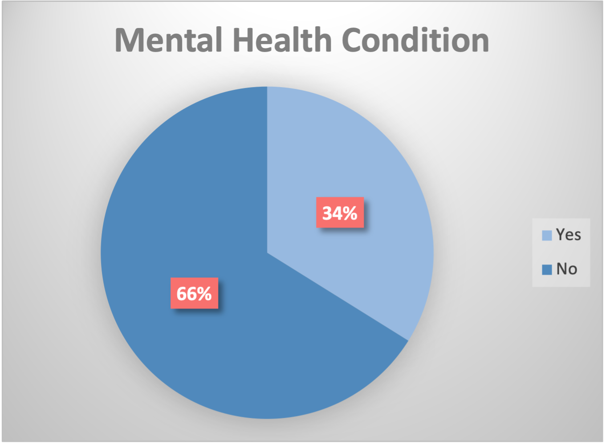
Mental health & Heart Disease

Slide 10
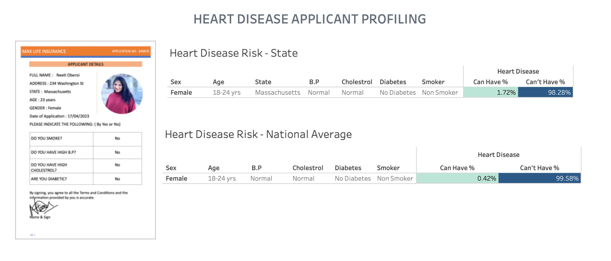
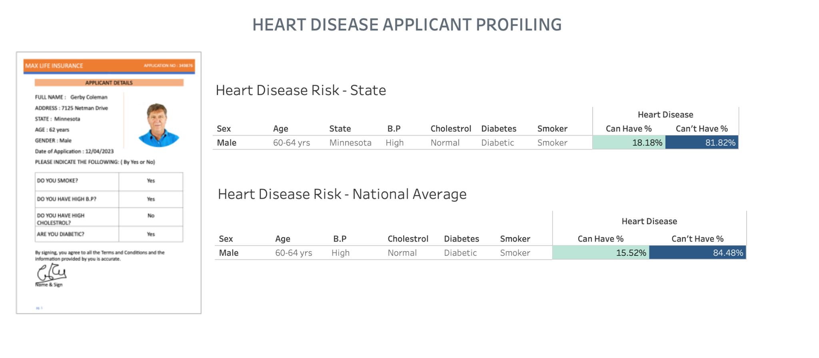
Insurance Applicants Profiling

Slide 11





Inferences
1
High Blood Pressure (B.P)
2
High Cholesterol
3
Smoking
4
Diabetes
5
Mental Health

Slide 12

Sounds pretty general right?
What’s new? We know this but it’s still an issue today…
80% of heart diseases can be prevented
But, it’s all in our lifestyle!

Slide 13
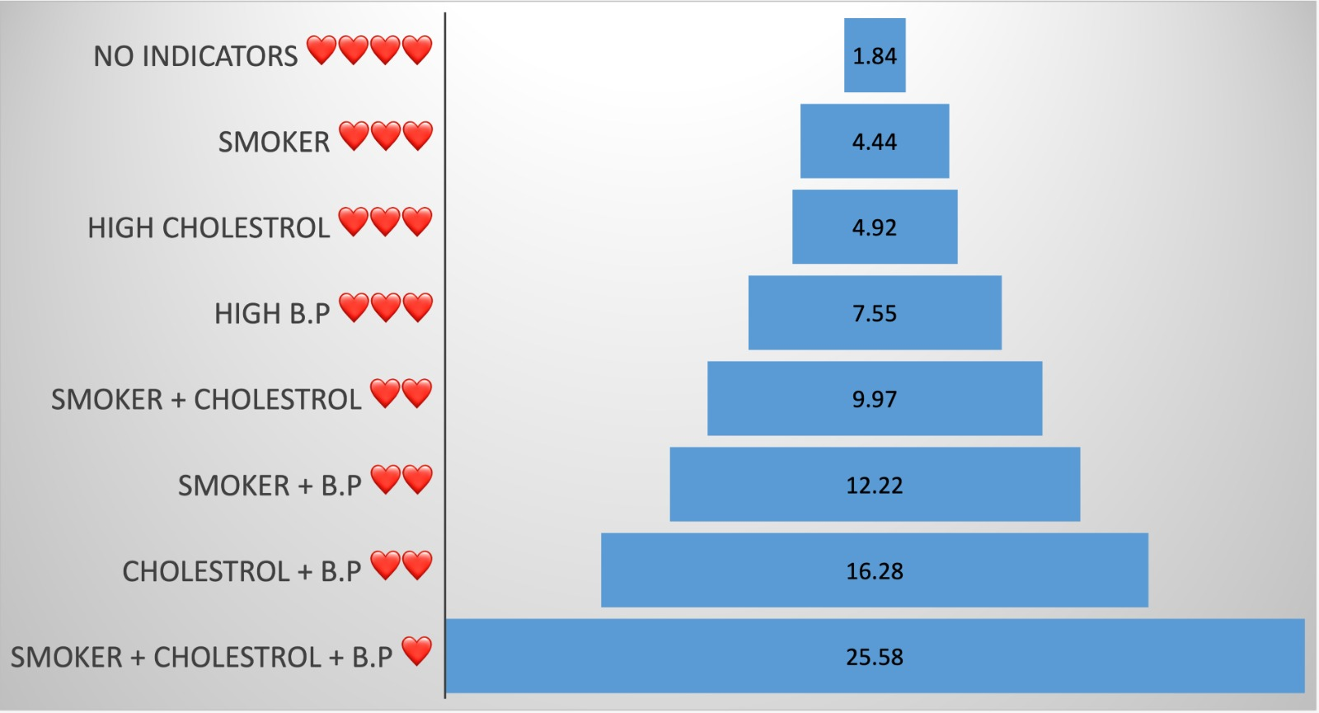
Heart Disease Risk % - By Indicators
%
%
%
%
+
%
%
%
%

Slide 14
Recommendations and Incentives Plan
Why?
Invest in your Health, Reap the Rewards
How it works?
🌟 Sign up for the program, by taking a free health checkup - Get 💲50
🌟Choose upto 2 goals/month
🎯Goals:
✅Clock 8k steps 👣 per day (BMI, Cholesterol, BP)
✅No extra sugar ❌ (Diabetes)
✅Reduce 5lbs (BMI, Cholesterol)
✅Smoke free 🚭 (Smokers)
✅Join a stress management group 👥 (Mental health, BP)
Based on 21/90 Rule
Average Insurance 💲spent on 1 👤with H.D = $ 73,000
⬇️ Risk by 5%, translates to a decrease about $3650 per person
Reducing subsequent costs for future consultations and tests as opposed to having the HD indicators
It’s a Win-Win situation for both

Slide 15
REWARDS
$100💰
1
Smart Watch ⌚
1 Month
2
2 Months
$300💰
3
3 Months
Additionally, screen people every year to revise health plan insurance coverage.

Slide 16

THANKS!
Because…
Prevention is Better
Than Cure!

